Slide 1
Competitive Tetris:
How to Play and How to Cope
Fareed Sheriff & Daniel Vuong

Slide 2
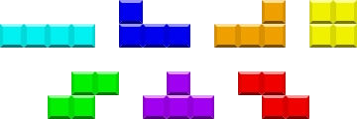
Introduction
Tetris has existed for almost 4 decades
There are 7 tetrominoes
The goal of the original game is to get as high of a score as you can
In competitive NEStris (traditional Tetris), the goal is to beat your opponent’s score
Competitive Tetris nowadays refers to Tetris that gives you the ability to send “garbage” to your opponent
https://static.wikia.nocookie.net/tetrisconcept/images/c/ca/Tetromino_image.png/revision/latest?cb=20090706171943

Slide 3
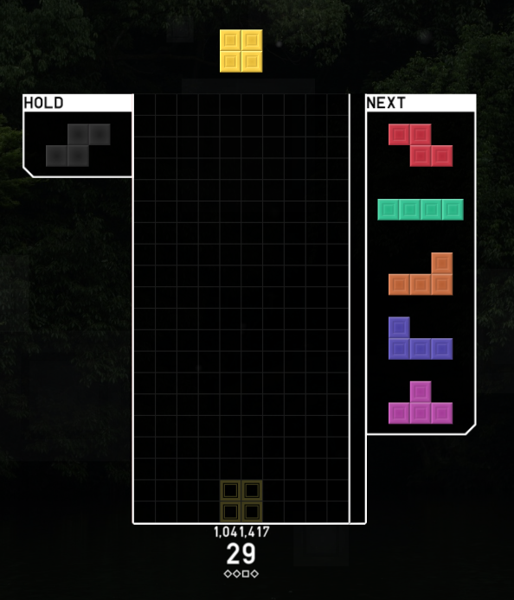

Slide 4
TETR.IO
Competitive multiplayer Tetris website
Great design
The goal is to make your opponent top out
Both players make moves and certain moves can send your opponent garbage
Played on a 40x10 board with a 5-piece queue and unit hold

Slide 5
How to Send Garbage
Combo (4-wide)
Clear 2 or more lines
T-spin
PC

Slide 6
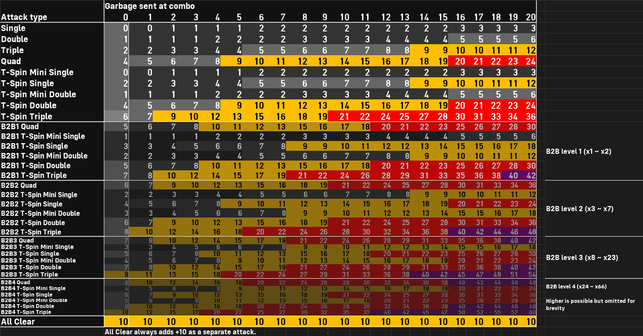
Combo Table
https://tetris.wiki/images/9/96/TETR.IO_Combo-Table.png

Slide 7
Optimal Gameplay
Finesse
Combo-spotting & effective spinning
Speed
Board-watching
These four categories yield optimal gameplay - not just high attack, but also the ability to stay alive in dangerous situations
Adjusting your settings will also result in better gameplay - lower your DAS as much as possible

Slide 8


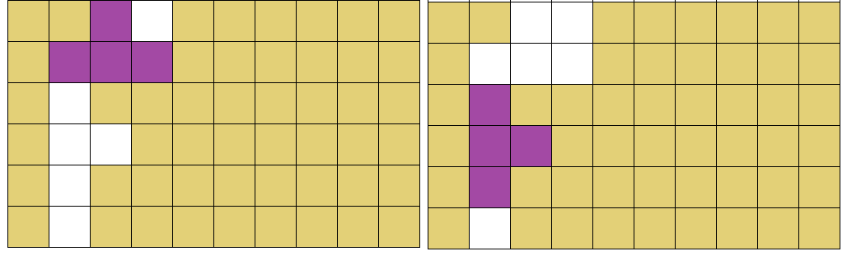
Common T-spins
Single - sends 2 lines
Double (TSD) - sends 4 lines
Triple (TST) - sends 6 lines
four.lol
https://2.bp.blogspot.com/-yRVG7PCi5LY/Vgx8D3vnU5I/AAAAAAAAC1c/mcqqO6pbN6Q/s1600/tetris%2Bt%2Bspin%2Btriple.png

Slide 9
Other Spins
Every piece but O can be spun
Example will be shown

Slide 10
Openers
Goal is to send a lot of attack at the start of the game
PCO
DT Cannon
T-spin openers

Slide 11
How to Cope
TETR.IO can be a very frustrating game at times
There will always be players better than you
The four main skills Tetrio players need are speed, accuracy, creativity, and patience/perseverance
You can have the first three skills, but without the last one, you go from a great player to a good one
Never give up in the middle of a game
If you realize you suck at something, don’t whine about it; try to cover your weakness
Improving is especially easy in TETR.IO because there aren’t too many categories to improve in, but maxing out any category is still very difficult and requires time and practice
A good resource is four.lol --- contains tutorials on openers and finesse, and has other tips and tricks

Slide 12
Let’s Play!
We will now play TETR.IO against each other
You do not need to create an account to play
We will start with no attack enabled, then move to a low garbage multiplier

